Slide 1
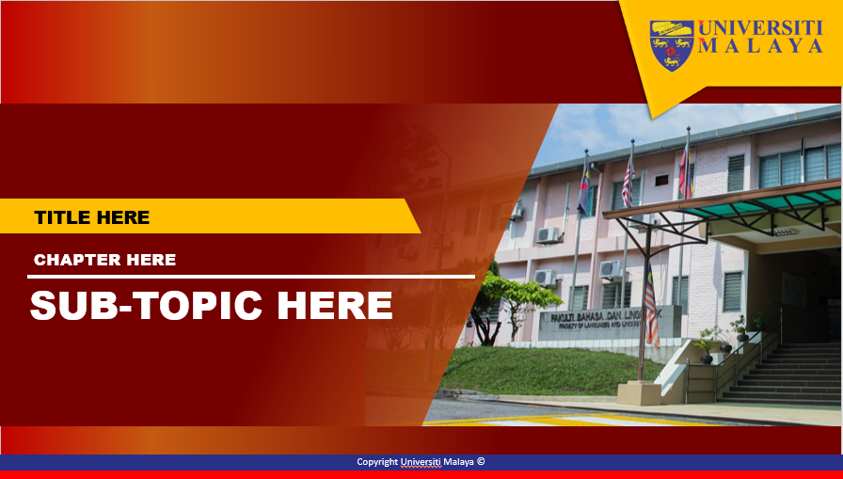
FAKULTI BAHASA DAN LINGUISTIK
GBT 0002 : CRITICAL THINKING AND PROBLEM SOLVING SKILLS
PN SITI ROHANA BINTI MOHD THANI
srohana@um.edu.my
603-7967 3116

Slide 2

WEEK 5
DETECTING FALLACIES 2

Slide 3
Logical Fallacies
2
Continuing our foray into the world of Argument
Siti Rohana Binti Mohd Thani
Siti Rohana Mohd Thani
Courtesy of: http://www.unc.edu/depts/wcweb/handouts/fallacies.html

Slide 4
What is Fallacy?
Refresh & continue from Part 1
are defects that weaken arguments.
First, fallacious arguments are very, very common and can be quite persuasive, at least to the causal reader or listener. You can find dozens of examples of fallacious reasoning in newspapers, advertisements, and other sources.
Second, it is sometimes hard to evaluate whether an argument is fallacious.
An argument might be very weak, somewhat weak, somewhat strong, or very strong. An argument that has several stages or parts might have some strong sections and some weak ones.
Siti Rohana Mohd Thani

Slide 5
Fallacies
1. Hasty Generalization
2. Missing the Point
3. Post Hoc (False Cause)
4. Slippery Slope
5. Weak Analogy
6. Appeal to Authority
7. Appeal to Ignorance
8. False Dichotomy (Alternative)
9. Loaded Question
10. Inconsistency
Siti Rohana Mohd Thani

Slide 6
1.Hasty Generalization
Definition: Making assumptions about a whole group or range of cases based on a sample that is inadequate (usually because it is atypical or just too small).
  Stereotypes about people ("frat boys are drunkards," "grad students are nerdy," etc.) are a common example of the principle underlying hasty generalization.
Example: "My roommate said her philosophy class was hard, and the one I'm in is hard, too. All philosophy classes must be hard!"
  Two people's experiences are, in this case, not enough on which to base a conclusion.
Siti Rohana Mohd Thani

Slide 7
2. Missing the Point
Definition: The premises of an argument do support a particular conclusion--but not the conclusion that the arguer actually draws.
Example: "The seriousness of a punishment should match the seriousness of the crime. Right now, the punishment for drunk driving may simply be a fine. But drunk driving is a very serious crime that can kill innocent people. So the death penalty should be the punishment for drunk driving."
  The argument actually supports several conclusions-- "The punishment for drunk driving should be very serious," in particular--but it doesn't support the claim that the death penalty, specifically, is warranted.
Siti Rohana Mohd Thani

Slide 8
3.Post hoc (false cause)
This fallacy gets its name from the Latin phrase "post hoc, ergo propter hoc," which translates as "after this, therefore because of this."
Definition: Assuming that because B comes after A, A caused B.
  Of course, sometimes one event really does cause another one that comes later--for example, if I register for a class, and my name later appears on the roll, it's true that the first event caused the one that came later. But sometimes two events that seem related in time aren't really related as cause and event. That is, correlation isn't the same thing as causation.
Examples: "President Jones raised taxes, and then the rate of violent crime went up. Jones is responsible for the rise in crime.“
  The increase in taxes might or might not be one factor in the rising crime rates, but the argument hasn't shown us that one caused the other.
Siti Rohana Mohd Thani

Slide 9
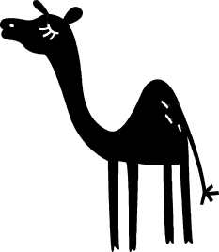
4. Slippery Slope
Also known as “the Camel’s Nose
Definition: The arguer claims that a sort of chain reaction, usually ending in some dire consequence, will take place, but there's really not enough evidence for that assumption.
  The arguer asserts that if we take even one step onto the "slippery slope," we will end up sliding all the way to the bottom; he or she assumes we can't stop halfway down the hill.
Example: "Animal experimentation reduces our respect for life. If we don't respect life, we are likely to be more and more tolerant of violent acts like war and murder. Soon our society will become a battlefield in which everyone constantly fears for their lives. It will be the end of civilization. To prevent this terrible consequence, we should make animal experimentation illegal right now."
  Since animal experimentation has been legal for some time and civilization has not yet ended, it seems particularly clear that this chain of events won't necessarily take place.
Siti Rohana Mohd Thani

Slide 10
5.Weak Analogy
Definition: Many arguments rely on an analogy between two or more objects, ideas, or situations. If the two things that are being compared aren't really alike in the relevant respects, the analogy is a weak one, and the argument that relies on it commits the fallacy of weak analogy.
Example: "Guns are like hammers--they're both tools with metal parts that could be used to kill someone. And yet it would be ridiculous to restrict the purchase of hammers--so restrictions on purchasing guns are equally ridiculous."
Eg: Lettuce is leafy and green and tastes great with a veggie burger. Poison ivy is also green. Therefore, poison ivy probably tastes great with a veggie burger, too.
Siti Rohana Mohd Thani

Slide 11
6.Appeal to Authority
Definition: Often we add strength to our arguments by referring to respected sources or authorities and explaining their positions on the issues we're discussing.
  If, however, we try to get readers to agree with us simply by impressing them with a famous name or by appealing to a supposed authority who really isn't much of an expert, we commit the fallacy of appeal to authority.
Example: "We should abolish the death penalty. Many respected people, such as actor Guy Handsome, have publicly stated their opposition to it."
  While Guy Handsome may be an authority on matters having to do with acting, there's no particular reason why anyone should be moved by his political opinions--he is probably no more of an authority on the death penalty than the person writing the paper.
Siti Rohana Mohd Thani

Slide 12
7. Appeal to Ignorance
Definition: In the appeal to ignorance, the arguer basically says, "Look, there's no conclusive evidence on the issue at hand. Therefore, you should accept my conclusion on this issue."
Example: "People have been trying for centuries to prove that UFO exists. But no one has yet been able to prove it. Therefore, UFO does not exist."
Here's an opposing argument that commits the same fallacy:
  In each case, the arguer tries to use the lack of evidence as support for a positive claim about the truth of a conclusion. There is one situation in which doing this is not fallacious: If qualified researchers have used well-thought-out methods to search for something for a long time, they haven't found it, and it's the kind of thing people ought to be able to find, then the fact that they haven't found it constitutes some evidence that it doesn't exist.
Siti Rohana Mohd Thani

Slide 13
8.False Dichotomy (Alternative)
Definition: In false dichotomy, the arguer sets up the situation so it looks like there are only two choices. The arguer then eliminates one of the choices, so it seems that we are left with only one option: the one the arguer wanted us to pick in the first place.
Example: "Caldwell Hall is in bad shape. Either we tear it down and put up a new building, or we continue to risk students' safety. Obviously we shouldn't risk anyone's safety, so we must tear the building down."
  The argument neglects to mention the possibility that we might repair the building or find some way to protect students from the risks in question--for example, if only a few rooms are in bad shape, perhaps we shouldn't hold classes in those rooms.
Siti Rohana Mohd Thani

Slide 14
Loaded Question
9.
This fallacy occurs when an arguer asks a question that contains an unfair or unwarranted presupposition.
Like eg below either answers (yes or no) will force the person to admit something that he/she doesn’t want to admit.
Eg: Joe: Have you stopped cheating on exams?
Pete: No!
Joe: Oh,so you admit that you still cheat on exams?
Pete: No, I meant to say yes!
Joe: Oh, so you admit that you used to cheat on exams?
Pete; No!
Siti Rohana Mohd Thani

Slide 15
10. Inconsistency
Two statements are inconsistent when they both can’t be true. It occurs when an arguer asserts inconsistent or contradictory claims.
Eg:
A: Preferential treatment is unfair and discriminatory. It has no
place in college admissions.
B: But didn’t you say a minute ago that you got into this college
only because your father was a rich alumnus?
A: Well, yeah. But what’swrong with that?
B: Just checking, man.
Siti Rohana Mohd Thani

Slide 16
Can you name this Fallacy?
1) It is ridiculous to have spent thousands of dollars to rescue those two whales trapped in the Arctic ice. Why look at all the people trapped in jobs they don’t like.
Siti Rohana Mohd Thani

Slide 17
Can you name this Fallacy?
1) It is ridiculous to have spent thousands of dollars to rescue those two whales trapped in the Arctic ice. Why look at all the people trapped in jobs they don’t like.
RED HERRING
Siti Rohana Mohd Thani

Slide 18
Can you name this Fallacy?
2.Plagiarism is deceitful because it is dishonest.
Siti Rohana Mohd Thani

Slide 19
Can you name this Fallacy?
2) Plagiarism is deceitful because it is dishonest.
BEGGING THE QUESTION
Siti Rohana Mohd Thani

Slide 20
Can you name this Fallacy?
3.Water fluoridation affects the brain. Citywide,student’s test scores began to drop five months after fluoridation began.
Siti Rohana Mohd Thani

Slide 21
Can you name this Fallacy?
3) Water fluoridation affects the brain. Citywide, student’s test scores began to drop five months after fluoridation began.
POST HOC (false cause)
Siti Rohana Mohd Thani

Slide 22
Can you name this Fallacy?
4) I know three redheads who have terrible tempers, and since Annabel has red hair, I’ll bet she has a terrible temper too.
Siti Rohana Mohd Thani

Slide 23
Can you name this Fallacy?
4) I know three redheads who have terrible tempers, and since Annabel has red hair, I’ll bet she has a terrible temper too.
HASTY GENERALIZATION
Siti Rohana Mohd Thani

Slide 24
Can you name this Fallacy?
5) Supreme Court Justice Byron White was an All-American football player while in college, so how can you say that athletes are dumb?
Siti Rohana Mohd Thani

Slide 25
Can you name this Fallacy?
5) Supreme Court Justice Byron White was an All-American football player while in college, so how can you say that athletes are dumb?
HASTY GENERALIZATION
Siti Rohana Mohd Thani

Slide 26
Can you name this Fallacy?
6) Why should we put people on trial when we know they are guilty?
Siti Rohana Mohd Thani

Slide 27
Can you name this Fallacy?
6) Why should we put people on trial when we know they are guilty?
BEGGING THE QUESTION
Siti Rohana Mohd Thani

Slide 28
Can you name this Fallacy
7) You support capital punishment just because you want an “eye for an eye,” but I have several good reasons to believe that capital punishment is fundamentally wrong…
Siti Rohana Mohd Thani

Slide 29
Can you name this Fallacy?
7) You support capital punishment just because you want an “eye for an eye,” but I have several good reasons to believe that capital punishment is fundamentally wrong…
STRAW MAN
Siti Rohana Mohd Thani

Slide 30
Can you name this Fallacy?
8) The meteorologist predicted the wrong amount of rain for May. Obviously the meteorologist is unreliable.
Siti Rohana Mohd Thani

Slide 31
Can you name this Fallacy?
8) The meteorologist predicted the wrong amount of rain for May. Obviously the meteorologist is unreliable.
HASTY GENERALIZATION
Siti Rohana Mohd Thani

Slide 32
Can you name this Fallacy?
9) You know Jane Fonda’s exercise video’s must be worth the money. Look at the great shape she’s in.
Siti Rohana Mohd Thani

Slide 33
Can you name this Fallacy?
9) You know Jane Fonda’s exercise video’s must be worth the money. Look at the great shape she’s in.
POST HOC (false cause)
Siti Rohana Mohd Thani

Slide 34
Can you name this Fallacy?
10) We have to stop the tuition increase! The next thing you know, they'll be charging $40,000 a semester!
Siti Rohana Mohd Thani

Slide 35
Can you name this Fallacy?
10) We have to stop the tuition increase! The next thing you know, they'll be charging $40,000 a semester!
SLIPPERY SLOPE
Siti Rohana Mohd Thani

Slide 36
Can you name this Fallacy?
11) The book Investing for Dummies really helped me understand my finances better. The book Chess for Dummies was written by the same author, was published by the same press, and costs about the same amount, so it would probably help me understand my finances as well.
Siti Rohana Mohd Thani

Slide 37
Can you name this Fallacy?
11) The book Investing for Dummies really helped me understand my finances better. The book Chess for Dummies was written by the same author, was published by the same press, and costs about the same amount, so it would probably help me understand my finances as well.
WEAK ANALOGY
Siti Rohana Mohd Thani

Slide 38
Can you name this Fallacy?
12) Look, you are going to have to make up your mind. Either you decide that you can afford this stereo, or you decide you are going to do without music for a while.
Siti Rohana Mohd Thani

Slide 39
Can you name this Fallacy?
12) Look, you are going to have to make up your mind. Either you decide that you can afford this stereo, or you decide you are going to do without music for a while.
FALSE DICHOTOMY (Alternative)
Siti Rohana Mohd Thani

Slide 40
Can you name this Fallacy?
13) I'm positive that my work will meet your requirements. I really need the job since my grandmother is sick.
Siti Rohana Mohd Thani

Slide 41
Can you name this Fallacy?
13) I'm positive that my work will meet your requirements. I really need the job since my grandmother is sick.
APPEAL TO PITY
Siti Rohana Mohd Thani

Slide 42
Can you name this Fallacy?
14) Crimes of theft and robbery have been increasing at an alarming rate lately. The conclusion is obvious, we must reinstate the death penalty immediately
Siti Rohana Mohd Thani

Slide 43
Can you name this Fallacy?
14) Crimes of theft and robbery have been increasing at an alarming rate lately. The conclusion is obvious, we must reinstate the death penalty immediately.
MISSING THE POINT
Siti Rohana Mohd Thani

Slide 44
Can you name this Fallacy?
15) I'm not a doctor, but I play one on the hit series "Bimbos and Studmuffins in the OR." You can take it from me that when you need a fast acting, effective and safe pain killer there is nothing better than MorphiDope 2000. That is my considered medical opinion.
Siti Rohana Mohd Thani

Slide 45
Can you name this Fallacy?
15) I'm not a doctor, but I play one on the hit series "Bimbos and Studmuffins in the OR." You can take it from me that when you need a fast acting, effective and safe pain killer there is nothing better than MorphiDope 2000. That is my considered medical opinion.
APPEAL TO AUTHORITY
Siti Rohana Mohd Thani

Slide 46
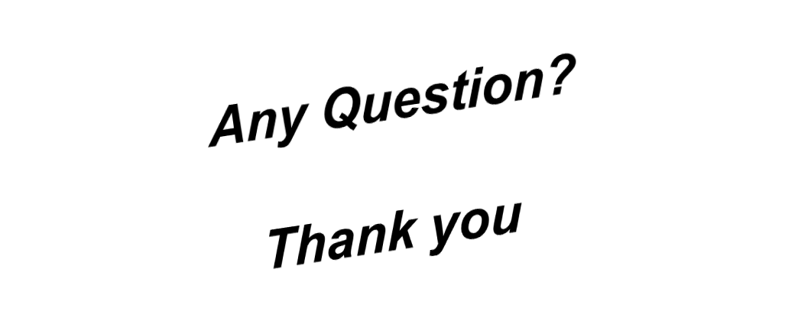
Siti Rohana Mohd Thani

